Slide 1

A DESCRIPTIVE OBSERVATIONAL PROSPECTIVE STUDY OF THE SPECTRUM OF POSTNATAL COMPLICATIONS OF PATIENTS IN TERTIARY CARE HOSPITAL.
A Project Submitted to
Dr. Babasaheb Ambedkar
Marathwada University,
Aurangabad.
For the Degree of
Doctor of Pharmacy (Pharm-D)
Government College of Pharmacy, Aurangabad.
DR. BABASAHEB AMBEDKAR MARATHWADA UNIVERSITY
AURANGABAD (M.S.) 431005, INDIA
2022-2023

Slide 2
SUBMITTED BY
Yogesh Kadam
Nagesh Raut
Santosh Kadam
Nikheel Patil
UNDER THE GUIDANCE OF
HOSPITAL GUIDE
DR. SHARAYU GARUD
ASSISTANT PROFESSORDEPARTMENT OF MEDICINE,
GOVERNMENT MEDICAL COLLEGE AND HOSPITAL,
AURANGABAD
COLLEGE GUIDE
DR. PRASHANT SHAMKUWAR
PROFESSOR GOVERNMENT COLLEGE OF PHARMACY,
AURANGABAD.

Slide 3
INDEX
Introduction
Research questions
Aim and objective
Methodology
Observation
Result
Discussion
Uniqueness/Limitations
Summary
Conclusion
References

Slide 4

What Are Postnatal Complications ?

Slide 5
The period later the delivery of the placenta and the subsequent six weeks is termed as the postpartum period (the terms postpartum/postpartum/puerperium may be used interchangeably). This is a critical time for the physical and mental health of the new mother.
During this period, drastic anatomical and physiological (pregnancy-related) changes occur in the pregnant mother to return from pregnancy to in the non-pregnant state, i.e. In the pre- pregnancy state. Therefore, the body undergoes significant physiological changes after delivery and are as important as pregnancy and delivery are in terms of risks to maternal health. Certain pregnancy-related diseases can manifest during abnormal puerperium. Termed as diseases of puerperium and postpartum complications.
An estimate shows, of the total global incidence of maternal mortality, 25% occurs in India alone. India observes the largest number of neonatal and maternal deaths in any single no. of necessary Complications related to pregnancy, childbirth, and postpartum period may cause death or continuous morbidities that affect a women's heath for a shorter or longer period during or after delivery.
Complications of the Puerperium(2021): These changes include those in the reproductive, urinary, cardiovascular, GI, and endocrine systems. Abnormal puerperium can range from potentially life-threatening diseases including severe hemorrhage in the immediate postnatal period, hypertensive complications and infections in the early postnatal period, and thrombosis/embolism throughout the puerperium, as well as complications due to pre-existing diseases, such as cardiac disease. Potentially non-life-threatening conditions includes other infections (urinary tract infection, mastitis, and wound infections)
breastfeeding disorders, incontinence, pelvic floor dysfunction, and postpartum thyroiditis ,

Slide 6
The spectrum of postpartum complications ranges from relatively self-limiting to life-threatening conditions that can be divided into eight categories:
1. Hemorrhage
Obstetric Haemorrhage, Antepartum haemorrhage-intrapartum haemorrhage, postpartum Haemorrhage
2. Hypertensive disorders in pregnancy, birth and puerperium
Hypertensive disorders of pregnancy-induced hypertension, Pre eclampsia, Eclampsia, HELLP Syndrome, Essential Hypertension
3. Pregnancy-related infection
Puerperal sepsis, Pyrexia of unknown origin following delivery, wound infections, urinary tract infections, and mastitis to a severe, sometimes septic course due to endometriosis.
4. Cardiac disorders:
Cardiomyopathy (antepartum, peripartum postpartum), Rheumatic heart disease, Congenital heart disease, Aortic aneurysm, myocardial infarction and Others

Slide 7
5. Endocrine Disorders
Diabetes Gestational diabetes mellitus Diabetes mellitus Thyroid Disorder Thyrotoxicosis Pheochromocytoma
6. Neurological Disorders: Epilepsy, Cortical vein thrombosis, Cerebral embolism (stroke), meningitis, encephalitis
7. Mental disorders in the puerperium: such as depressive disorders, anxiety disorders, and post-traumatic stress disorders represent yet another important group of diseases in the puerperium that is underestimated in terms of incidence.
8. Coagulative disorders:
septic thrombophlebitis, thromboembolism, Deep vein thrombosis and coagulopathy
Of all above-mentioned diseases regarded to global maternal mortality, approximately one-quarter of deaths occur in the antenatal and one-quarter in the perinatal period, while almost half occur in the puerperium and thereafter ³

Slide 8
RESEARCH QUESTION
What is post natal complications ?
How is spectrum of complications ?
What are clinical features of post natal patients ?
what are associated comorbidities and association of complications with Antenatal complications, other conditions and risk factors ?

Slide 9
AIM AND OBJECTIVES
The Primary objective
To study spectrum of complications in immediate postnatal patients
The Secondary objective
To describe Clinical profile of patients in PNC
To assess associated co-morbidities.
To study association of complications with Antenatal complications, other conditions and risk factors.
To study various investigations in diagnosis and management.
5) To study the outcomes of post-natal patients.

Slide 10
METHODOLOGY
Study Design
This was an Observational Prospective study.
The study was given ethical approval by Institutional Ethics Committee (IEC) of Government Medical College, Aurangabad (Pharmac/IEC-GMCA/Approval/229/2022).
Study population
The study started in December 2022 and continued until April 2023 for a duration of 100 days. Female patients in the age group of 18-40 years, diagnosed with postnatal complications were enrolled into the study. During the study period, the investigators went to the ICCU, MICU & female ward of the Medicine Department of the Government Medical College and Hospital, Aurangabad to check for newly admitted patients of PNC. Subjected to the inclusion and exclusion criteria, eligible patients were informed about the study. Interested patients were then asked to sign the Informed Consent Form (ICF) before they were enrolled into the study.
INCLUSION CRITERIA:
Adult female Patients Subjects under the age group of 18-40 years. diagnosed with postnatal complications (PNC) , admitted to ICCU,MICU, female medicine wards, GMCH who are willing to participate in the study.
EXCLUSION CRITERIA:
Subjects not in the age group of 18-40 years, not willing to participate in the study & Subject that are Discharged against medical advice. (DAMA)

Slide 11
Sample size
The study included a total of 72 subjects. enrolled between 20th December2022 to 31st march 2023.
Study procedure
Study protocol was submitted to the Institutional Ethics Committee (IEC) with approval letter attached
Eligible patients were identified according to the inclusion and exclusion criteria from ICCU, MICU female medicine wards, GMCH.
The aim and objectives of the study was explained in detail in layman terms to the patient and their Legally Acceptable Representative (LAR) verbally in vernacular language.
All of their doubts and reservations were answered equitably.
Interested patients were then enrolled in the study post singing of Informed Consent Form. In case the patient was unable to sign the ICF, consent was taken from their LAR on their behalf.
Case notes were reviewed and Resident doctors were consulted by the investigators. The required data was extracted onto a standardized Case Report Form.
The data not available in the case notes was bought by consulting the Resident Medicine Doctors posted in ICCU and the patient’s family.
After voluntary consent, subjects will be enrolled in the study .

Slide 12
IDEATION
LITERATURE REVIEW
PROTOCOL SUBMITION
APPROVAL FROM IEC
ENROLLMENT OF PATIENT
DATA COLLECTION BY USING CASE
EVALUATION OF CASE REPORT FORM
REPORT FORM
ANALYSIS USING APPROPRIATE BIOSTATISTICAL TOOLS

Slide 13
Observation and Results
Age Groups
Table 6 : Age
Range of age | No. of patients
18-20 | 18
21-30 | 43
31-40 | 10
41-50 | 1
Total Patients | 72
Figure 3 : Age (age bracket, no. of cases, %)
Amongst 72 subjects within the study population patients were distributed into the groups with various ranges above. It was found that patient belonging to age within 21-30 acno. of casesing for 60% of study population were the major contributors followed by patients within age of 15-20(25%) & 31-40(14%) and with least patients within age 41-50(1%).

Slide 14
Distribution based on Geographical Area
Table 7 : Rural/Urban Distribution
Type of residence | No of patients
Rural | 40
Urban | 32
Total | 72
56% (n = 40) of the total study population hailed from Rural area while only 32% (n = 44) were from Urban background.

Slide 15
Gravida
Table 15 : Gravida
Gravida no. | no. of cases
1 | 21
2 | 25
3 | 16
4 | 7
5 | 2
8 | 1
Grand Total | 72
Figure 12 : gravida obgy (gravida no, no. of cases, %)
Gravidity refers to the number of times a woman has been pregnant, regardless of whether the pregnancies were interrupted or resulted in a live birth.
The table shows the distribution of the number of pregnancies (gravida) among 72 patients. The majority of patients had either one (21) or two (25) pregnancies. There were also a significant number of patients with three (16) or four (7) pregnancies. Only a small number of patients had five (2) or eight (1) pregnancies.

Slide 16
Parity
Table 16 : parity
Parity | no. of cases
1 | 35
2 | 21
3 | 12
4 | 3
5 | 1
Grand Total | 72
Figure 13 : Parity obgy (parity, no. of cases, %)
Parity indicates the number of births (including live births and stillbirths) where pregnancies reached viable gestational age
Based on the provided data, there are a total of 72 patients in the study. Among these patients, the parity (number of previous live births) ranges from 1 to 5, with the majority of patients having a parity of 1 (35 patients, or 49% of the total). The number of patients with parity of 2, 3, 4, and 5 are 21 (29%), 12 (17%), 3 (4%), and 1 (1%) respectively.

Slide 17
Labour
Table 17 : Labour
Labour | no. of cases
0 | 3
1 | 37
2 | 18
3 | 11
4 | 2
5 | 1
Grand Total | 72
Figure 14 : Labour obgy (labour, no. of cases, %)
Labour is known as the process by which the products of conception are expelled from the Uterine cavity after the 24th week of gestation or pregnancy.
The distribution of the number of labors experienced by the patients in our dataset is as follows: 3 patients (4%) did not go into labor, 37 patients (51%) experienced labor once, 18 patients (25%) had two labors, 11 patients (15%) had three labors, 2 patients (3%) had four labors, and 1 patient (1%) had five labors.

Slide 18
Gestational Age
Table 18 : Gestational age
Gestational age ( week )range | no. of cases
1 to 10 | 1
11 to 20 | 3
21 to 30 | 8
31 to 40 | 58
Total | 72
The majority of patients (83%) had a gestational age between 31 to 40 weeks, while only a small percentage had a gestational age of 1 to 10 weeks (1%), or 11 to 20 weeks (4%), or 21 to 30 weeks (12%).

Slide 19
Bad Past Obstetrics History
Table 19 : h/o Miscarriages
Misscarriages | No
NO | 47
YES | 25
Grand Total | 72
among 72 patients. Out of the total, 65% of patients reported no history of miscarriage, while 35% reported a history of one or more miscarriages.

Slide 20
Mode of Delivery
Table 20 : Mode of delivery
Mode Of Delivery | no. of cases
CRIMINAL ABORTION | 1
CS ELECTIVE | 12
CS EMERGENCY | 21
MISCARRAGE | 1
MTP | 1
VAGINAL ASSISTED | 7
VAGINAL NORMAL | 28
Total | 72
The distribution of mode of delivery among 72 patients was as follows: 39% had a normal vaginal delivery, 29% had an emergency cesarean section, 17% had an elective cesarean section, and the remaining 15% had other delivery modes such as vaginal assisted, criminal abortion, miscarriage, and MTP.

Slide 21
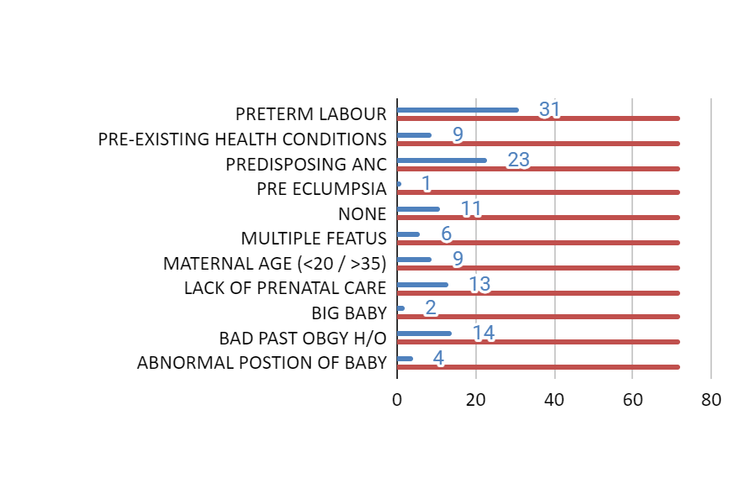
Risk Factor Towards Complication
Table 21 : Distribution Based on Risk Factors
Risk factor | Cases of RISK FACTORS | Out of TOTAL CASES
ABNORMAL POSTION OF BABY | 4 | 72
BAD PAST OBGY H/O | 14 | 72
BIG BABY | 2 | 72
LACK OF PRENATAL CARE | 13 | 72
MATERNAL AGE (<20 / >35) | 9 | 72
MULTIPLE FEATUS | 6 | 72
NONE | 11 | 72
PRE ECLUMPSIA | 1 | 72
PREDISPOSING ANC | 23 | 72
PRE-EXISTING HEALTH CONDITIONS | 9 | 72
PRETERM LABOUR | 31 | 72

Slide 22
Antepartum Care
Table 22 : Antepartum care
Ante-partum care Provided | Count
Yes | 57
No | 15
Total | 72
In this study, out of 72 patients, 57 (79%) received antepartum care, while 15 (21%) did not receive antepartum care.

Slide 23
Diagnosis
Table 23 : Diagnosis
Disease | Occurence among the Population | Total no. of Patients
MODS | 6 | 72
AFI | 8 | 72
AKI | 7 | 72
ANEMIA | 14 | 72
PREECLAMPSIA | 12 | 72
HELLP | 7 | 72
UTI | 6 | 72
LL DVT | 4 | 72
THROMBOCYTOPENIA | 5 | 72
PNEUMONIA | 4 | 72
LIVER DAMADE | 4 | 72
diseases among a population of 72 patients. The diseases included in the graph are MODS, AFI, AKI, anemia, preeclampsia, HELLP, UTI, LL DVT, thrombocytopenia, pneumonia, and liver damage.

Slide 24
Complications
Table 24 : Type of Post Natal Complications
Complication Type | Complication Occurrence | Within Total no. of patient.
HEMORRHAGE | 5 | 72
INFECTION | 38 | 72
HYPERTENSIVE DISORDERS OF PREGNANCY | 27 | 72
COAGULATIVE DISORDERS | 13 | 72
CARDIOPULMONARY DISORDERS | 10 | 72
HEMATOLOGICAL | 26 | 72
NEUROLOGICAL DISORDER | 9 | 72
ENDOCRINE DISORDER | 10 | 72
The most common complication type is infection, occurring in 38 out of 72 patients (53%).
Hypertensive disorders of pregnancy and hematological complications are also relatively common, occurring in 27 (38%) and 26 (36%) patients respectively.
Other complication types, such as coagulative disorders, cardiopulmonary disorders, neurological disorders, and endocrine disorders, are less common, occurring in 13 (18%), 10 (14%), 9 (13%), and 10 (14%) patients respectively.
Hemorrhage is the least common complication type, occurring in only 5 (7%) patients.

Slide 25
Antepartum Complications
Table 25 : anc
ANC | PREECLAPSIA | ANEMIA | INFECTIONS | GESTATIONAL HTN | PRETERM LABOR | NAD
Occurrence | 15 | 22 | 15 | 19 | 8 | 23
Total | 72 | 72 | 72 | 72 | 72 | 72
among a total of 72 patients
Preeclampsia: 15 patients (20.8%)
Anemia: 22 patients (30.6%)
Infections: 15 patients (20.8%)
Gestational hypertension: 19 patients (26.4%)
Preterm labor: 8 patients (11.1%)
No abnormality detected (NAD): 23 patients (31.9%)

Slide 26
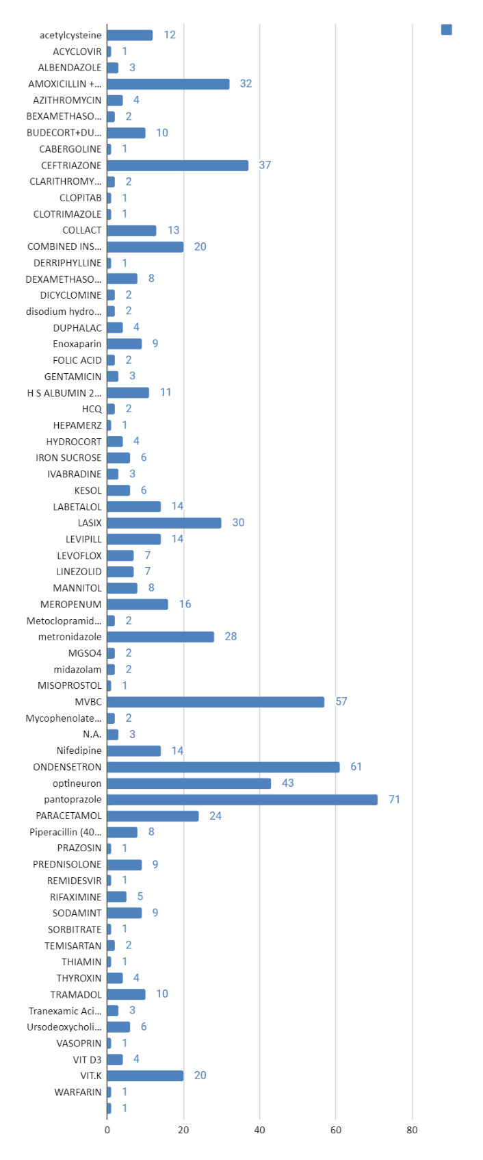
Pharmacotherapy and Supportive Management
Table 26 : Distribution based on Blood Transfusion Received
NO | 49
YES | 23
TOTAL | 72
the clinical management including drug therapy and supportive management were done based on the patient’s medical condition

Slide 27
DISSCUSSION
The study aimed to determine the spectrum of post-natal complications in patients at tertiary care hospitals. The findings showed that the majority of patients experienced one or more post-natal complications, with the most common beingThe most common complications were pregnancy related infection, Hypertensive disorders of pregnancy and hematological complications and Hemorrhage is the least common complication type.
It is important to monitor health of pregnanat women pre & post- delivery for any potential complications and providing appropriate management to improve patient outcomes.
Another significant finding was the higher risk of complications among patients with a history of pre-existing medical conditions such as hypertension and diabetes. This highlights the need for increased surveillance and management of these conditions during pregnancy and postpartum.
The study also identified a few limitations, such as the prospective nature of data collection and the possibility of missing some complications that were not documented in medical records. Nevertheless, the study provides important insights into the post-natal complications experienced by patients in tertiary care hospitals and can inform the development of better management strategies to improve patient outcomes.

Slide 28
UNIQNESS
There is a lack of comprehensive studies that have explored the spectrum of post-natal complications in patients at tertiary care hospitals.
It aims to identify the risk factors, prevalence, and outcomes of various post-natal complications such as postpartum hemorrhage, preeclampsia, infection, and thrombosis
The study will also investigate the factors that contribute to the development of these complications, such as age, maternal health, and delivery method.
By exploring the full range of post-natal complications and their contributing factors, this study will provide valuable insights into the needs of post-natal patients in tertiary care hospitals.
The findings of this study will help healthcare professionals to better understand post-natal complications and improve patient outcomes by developing more targeted treatment and management strategies.

Slide 29
LIMITATIONS OF THE STUDY
1. study conducted over a relatively short period of time, which may have limited our ability to capture the full spectrum of post-natal complications that can arise over a longer period,
study conducted only at medicine department of GMCH in 72 patients.
2. Another limitation is that the accuracy of our data on admission and treatment times may have been affected by the reliance on attending residents or nursing staff to record this information.
3. focus was solely on identifying the incidence and types of post-natal complications, and did not evaluate the adequacy, effectiveness, or potential complications of treatment and management strategies.
4. The study did not include an assessment of strategies to improve the prevention, diagnosis, and management of post-natal complications in tertiary care hospitals, which could have provided valuable insights into potential areas for improvement.

Slide 30
SUMMARY
The study found that the most common post-natal complications were infection (53%) Hypertensive disorders of pregnancy and hematological complications(38%) and 26 (36%) patients respectively. postpartum hemorrhage (17.5%), coagulative disorders, cardiopulmonary disorders, neurological disorders, and endocrine disorders13 (18%), 10 (14%), 9 (13%), and 10 (14%) patients respectively. Hemorrhage is the least common complication type, occurring in only 5 (7%) patients.
Factors that contributed to the development of post-natal complications included maternal age, pre-existing medical conditions, and delivery method.
The study did not evaluate the adequacy or effectiveness of treatment and management strategies for post-natal complications.
The study concluded that post-natal complications are a significant cause of morbidity and mortality among women and infants in India and suggested the need for developing specific hospital policies and guidelines to prevent, diagnose, and manage them effectively.

Slide 31
CONCLUSION
This study revealed that The most common complications were pregnancy related infection, Hypertensive disorders of pregnancy and hematological complications and Hemorrhage is the least common complication type.
The majority of the women did not receive adequate post- natal care and counselling.
The main factors contributing to the poor quality of post-natal care were lack of awareness, staff shortage, resource constraints and socio-cultural barriers. This study suggest the need for strengthening the post-natal care services.
Postnatal complications remain a significant burden in tertiary care hospitals, leading to increased morbidity and mortality rates among mothers and infants. This study highlights the need for systematic monitoring of postnatal complications in tertiary care hospitals and the importance of early detection and management of these complications.
Our findings suggest that a multifaceted approach, including appropriate antenatal mother care by staffing, training, and infrastructure, is needed to effectively manage postnatal complications and improve maternal and neonatal health outcomes.
Further research is needed to identify effective interventions for preventing and managing postnatal complications in tertiary care hospitals.
Overall, this study emphasizes the need for improved postnatal care in tertiary care hospitals to reduce the burden of postnatal complications and improve maternal and neonatal health outcomes.

Slide 32

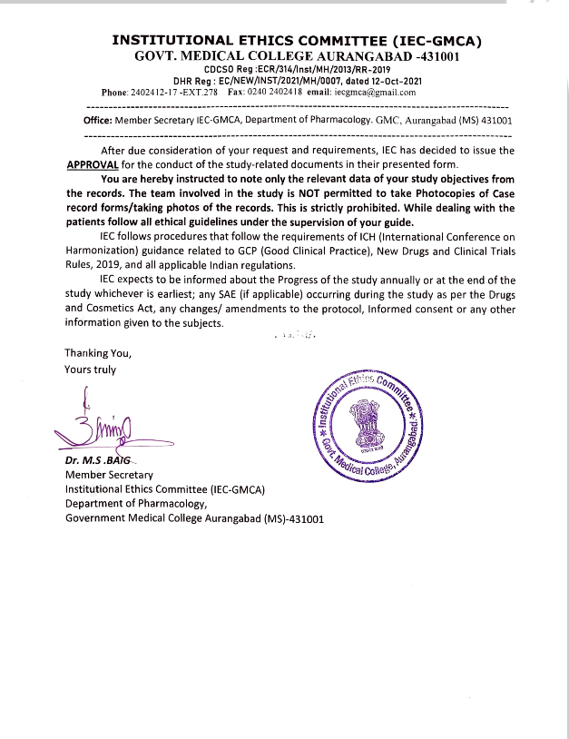

Slide 33
REFERENCES
Konar H. DC Dutta’s Textbook of Obstetrics. 2014.
Susanne Schrey-Petersen, Dr. med.,1,* Anne Tauscher, Dr.,1 Anne Dathan-Stumpf, Dr.,1 and Holger Stepan, Prof.1 Diseases and Complications of the Puerperium
https://www.ncbi.nlm.nih.gov/pmc/articles/PMC8381608/#:~:text=Fever%2C%20infection
) Vyas, N., Kamath, R., Pattanshetty, S., &Binu, V. S. (2016). Postpartum related morbidities among women visiting government health facilities in Udupi Taluk, Karnataka, India. Journal of family medicine and primary care, 5(2), 320–325.
https://doi.org/10.4103/2249-4863.192319
A Pictorial Review of Postpartum Complications
Marta Gonzalo-Carballes , Miguel Ángel Ríos-Vives, Eva Castellà Fierro, Xavier Gurí Azogue, Susana Gispert Herrero, Alberto Escudero Rodríguez, María Neus Rus, Marina Planes-Conangla, Jose Miguel Escudero-Fernandez, Pilar Coscojuela
https://pubs.rsna.org/doi/full/10.1148/rg.2020200031

Slide 34
Maternal mortality : Newsroom/Fact sheets/Detail/Maternal mortality
https://www.who.int/news-room/fact-sheets/detail/maternal-mortality
Say L, Chou D, Gemmill A et al. Global Causes of Maternal Death: A WHO Systematic Analysis. Lancet Global Health. 2014;2(6): e323-e333. https://www.thelancet.com/journals/langlo/article/PIIS2214-109X(14)70227-X/fulltext
Koblinsky, M., Chowdhury, M. E., Moran, A., &Ronsmans, C. (2012).
Maternal morbidity
and disability and their consequences: neglected agenda in maternal health. Journal of health, https://www.ncbi.nlm.nih.gov/pmc/articles/PMC3397324/
Centers for Disease Control and Prevention. Severe maternal morbidity in the United States [internet]. CDC; 2017 [cited 2019 Nov 25]. Available from:
https://www.cdc.gov/reproductive
https://www.cdc.gov/hearher/pregnant-postpartum-women/index.html

Slide 35


